Slide 1
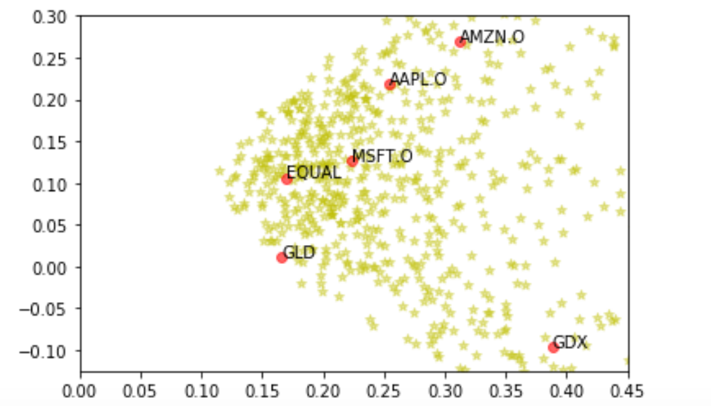
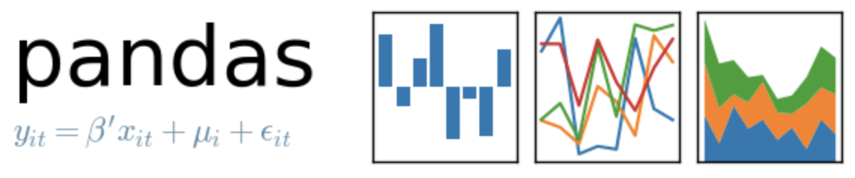
Portfolio Optimization
-
Equal Portfolio

Slide 2
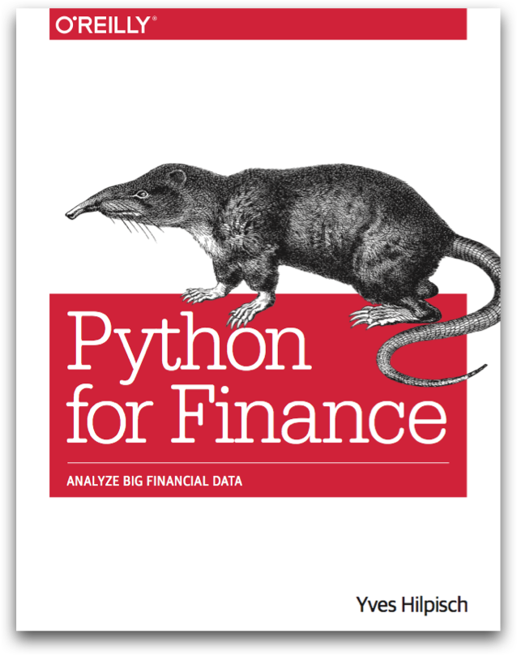
Reference
Chapter 11 of Python for Finance (O'Reilly)
Data
Youtube
Code

Slide 3
Data Loading

Slide 4
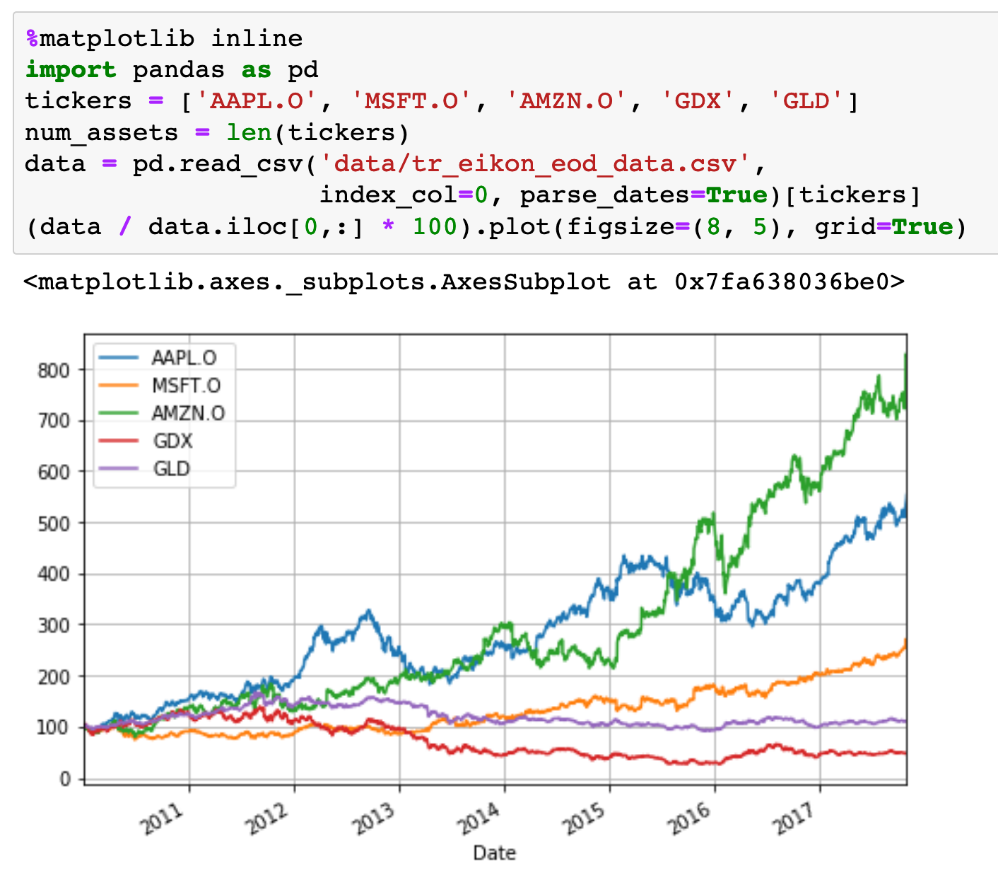

Slide 5
Computation
of
Mu and Sigma

Slide 6
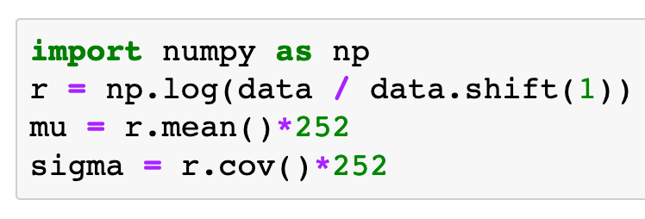
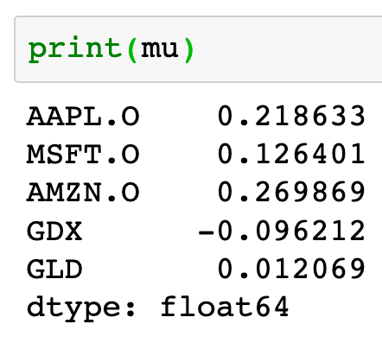
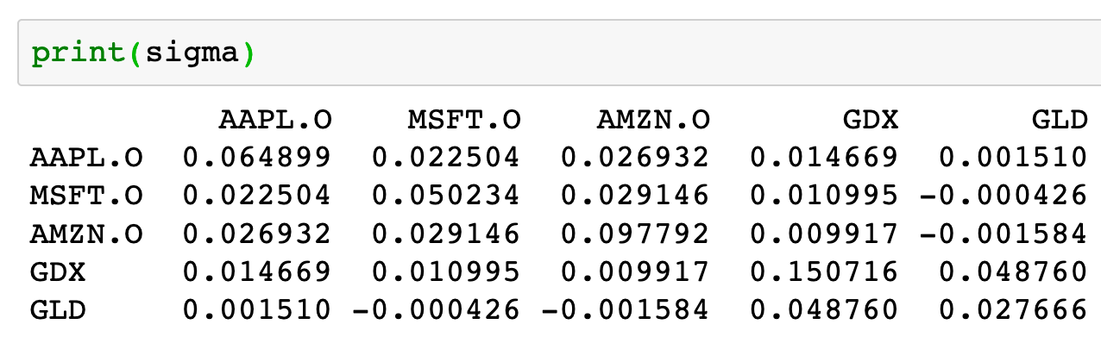

Slide 7
Risk-Return Plot

Slide 8
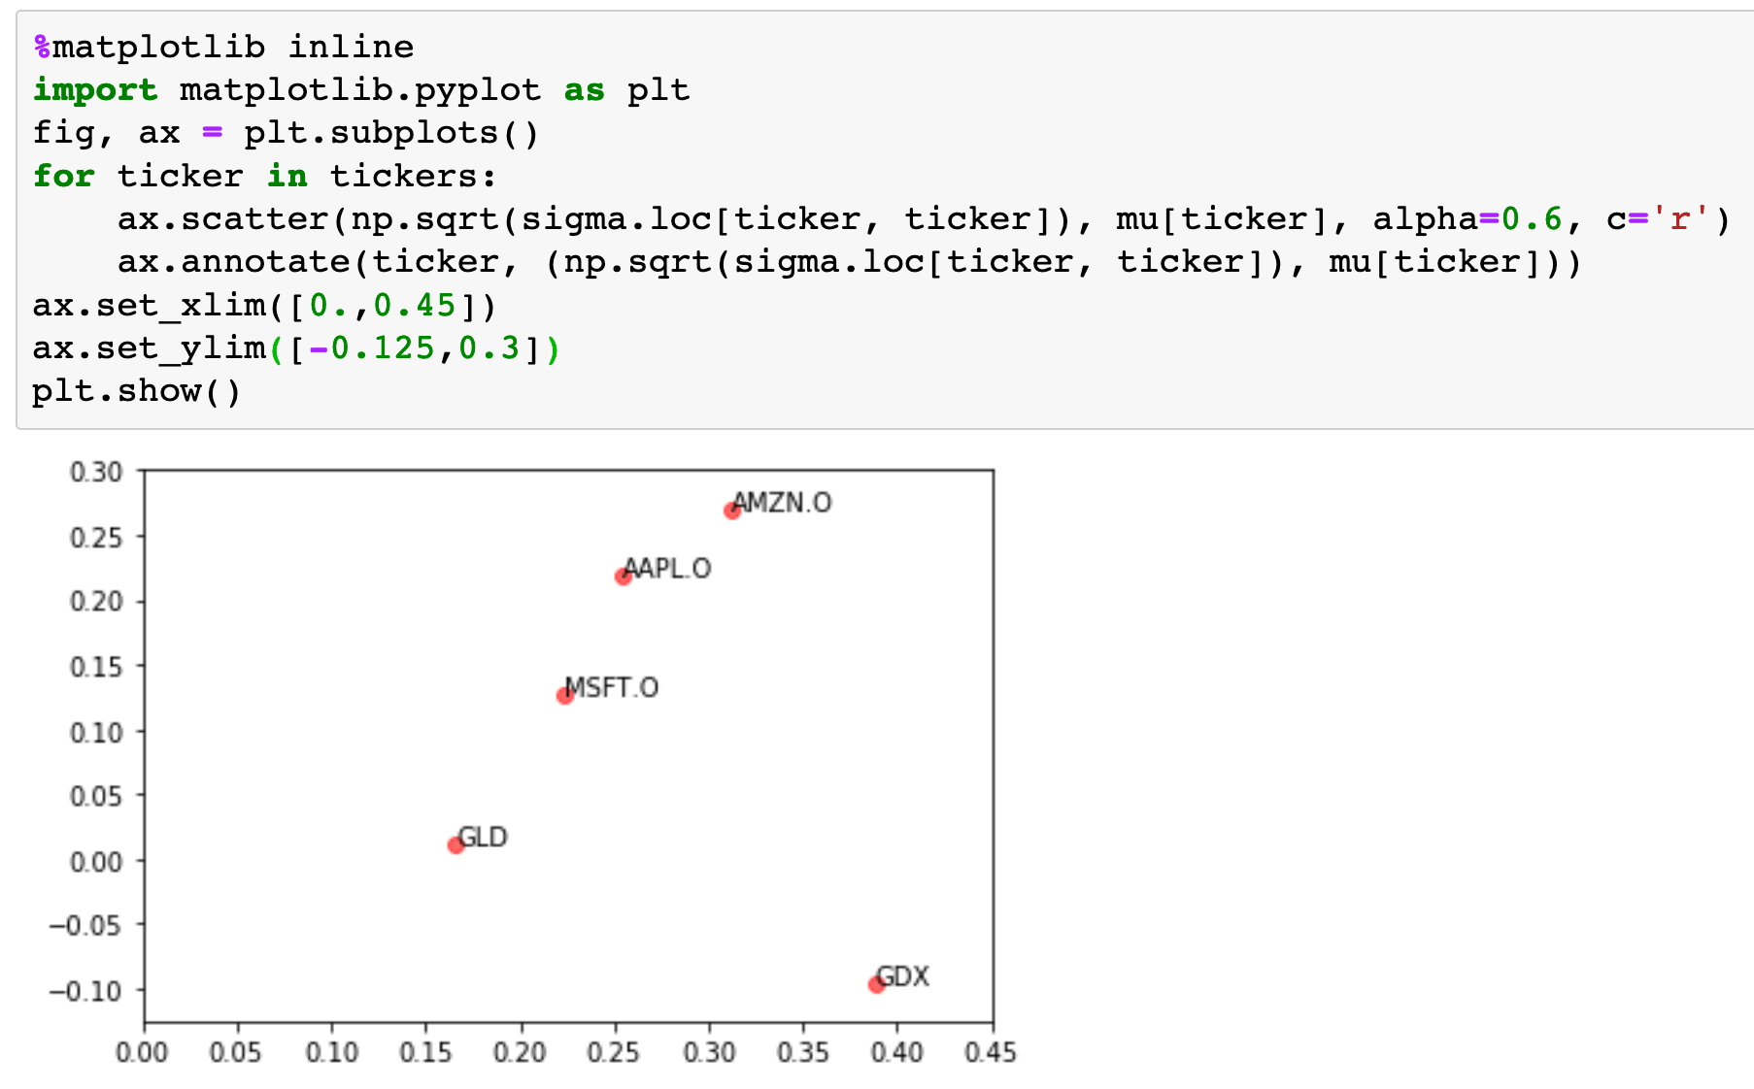

Slide 9
Copy
Original
Tickers, Mu and Sigma

Slide 10
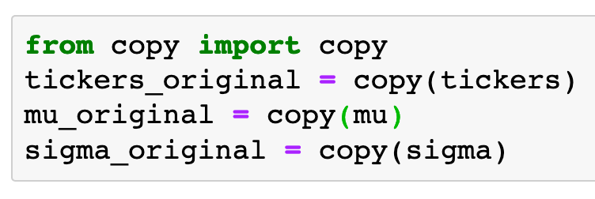

Slide 11
Computation
of
Portfolio’s Mu and Sigma

Slide 12
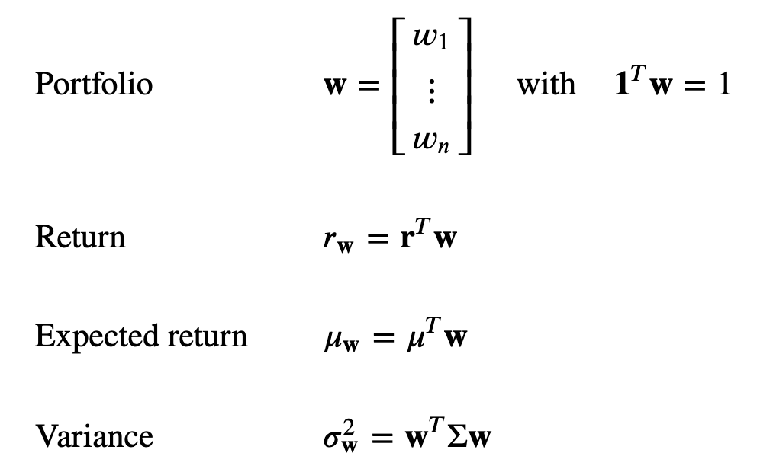

Slide 13
Random Portfolios
(No Short Positions)

Slide 14
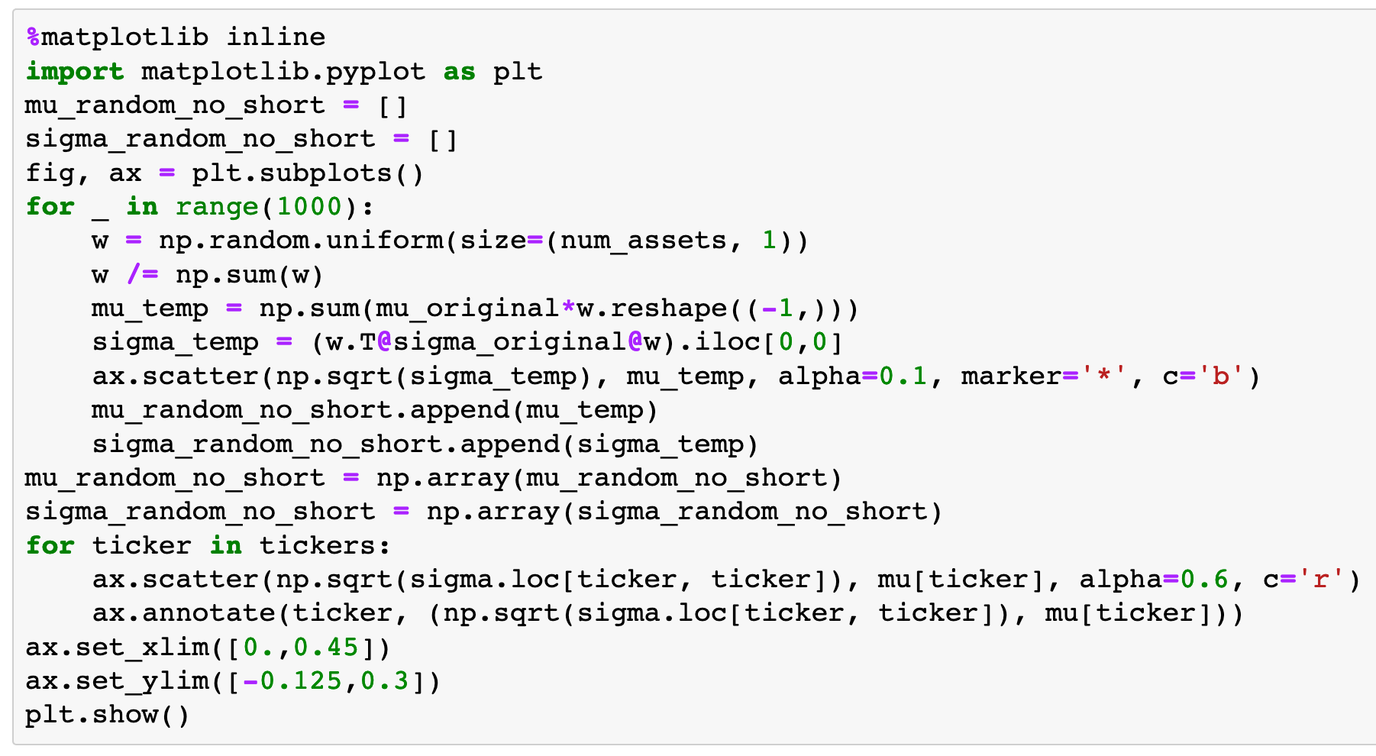

Slide 15
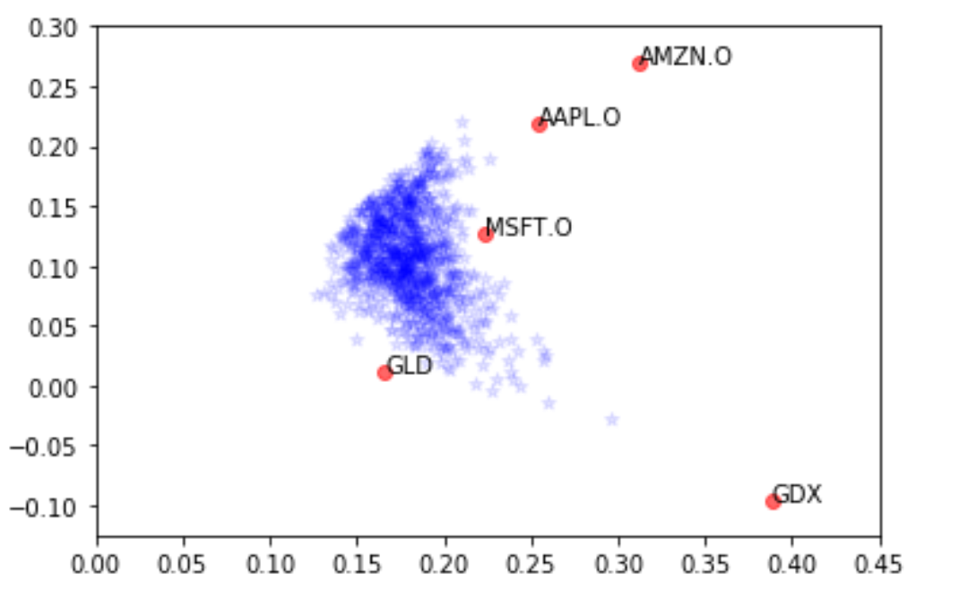

Slide 16
Random Portfolios
(Short Positions)

Slide 17
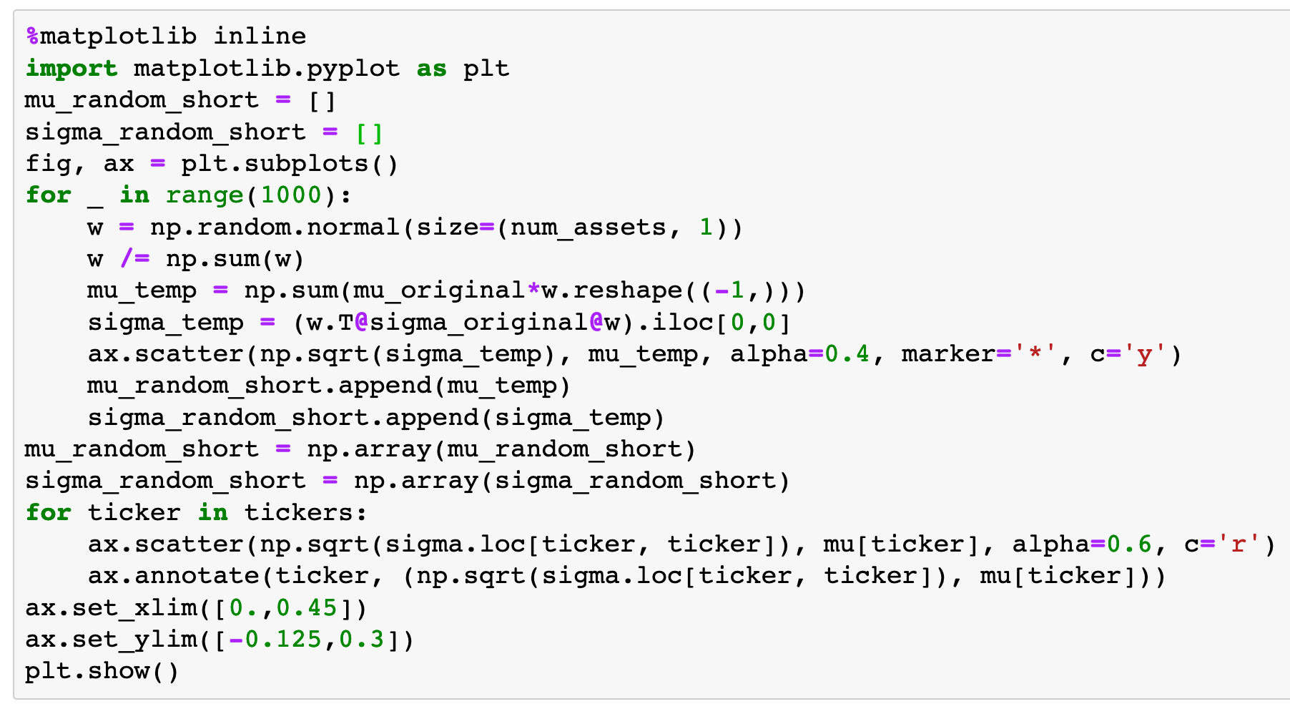

Slide 18
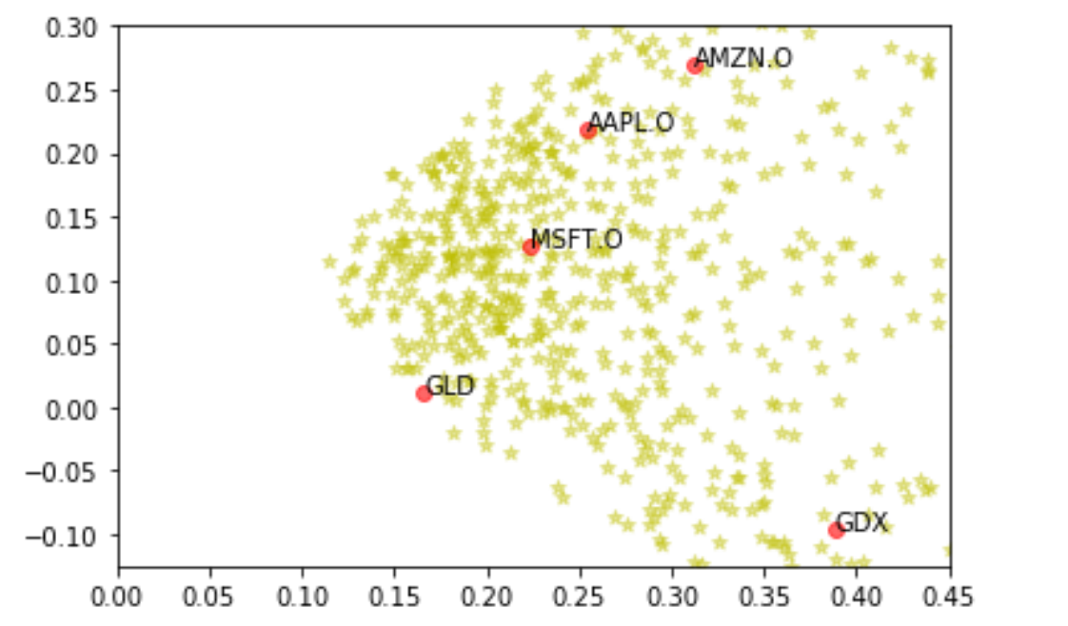

Slide 19
Equal Portfolio

Slide 20
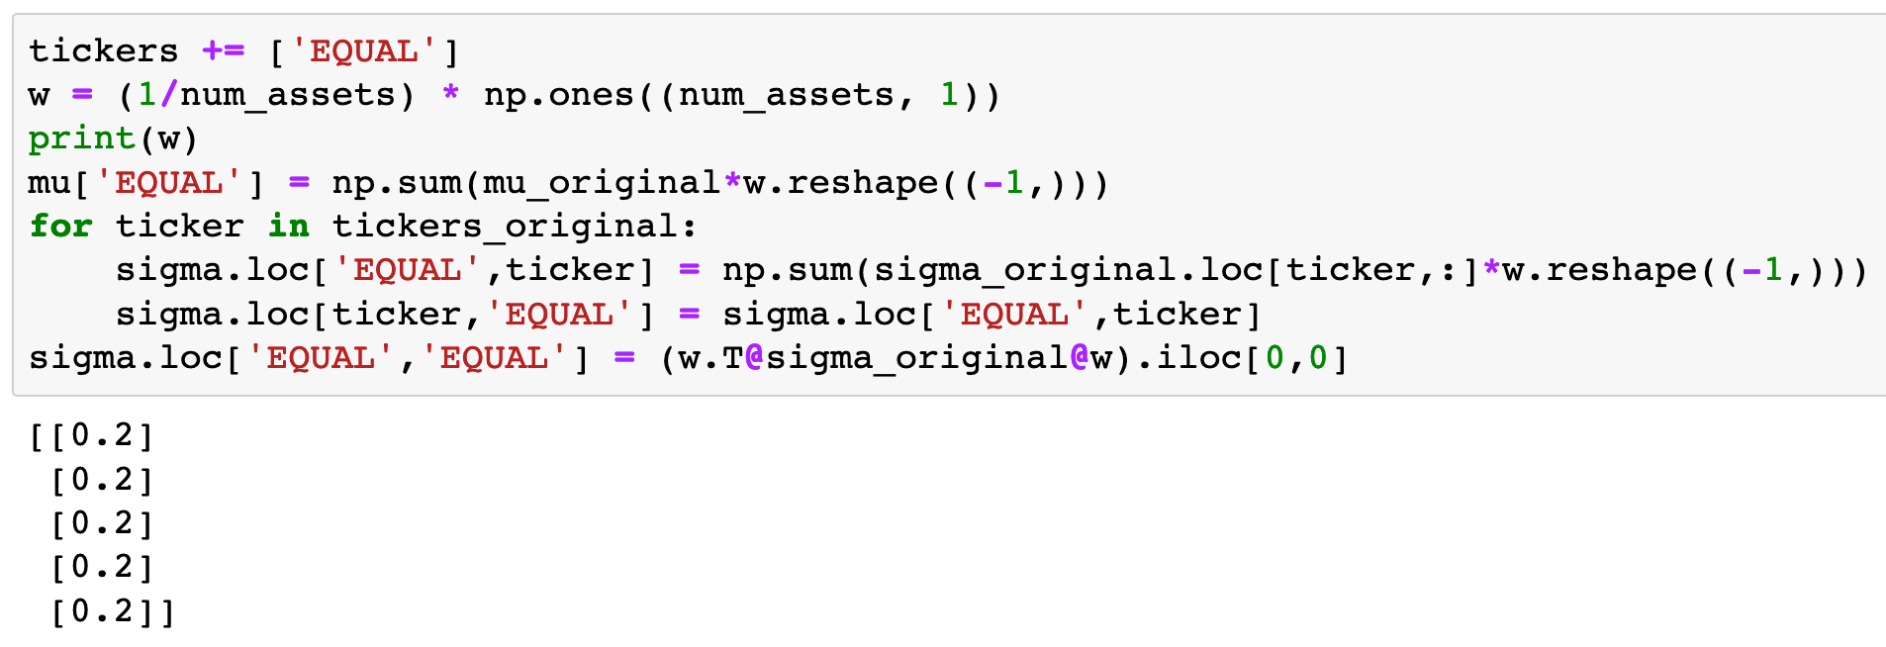

Slide 21
Equal Portfolio

Slide 22
Equal Portfolio

Slide 26
(5,)

Slide 27
(5,)
(5,)

Slide 28
Numpy
Array

Slide 29
Pandas
Series
Numpy
Array

Slide 30
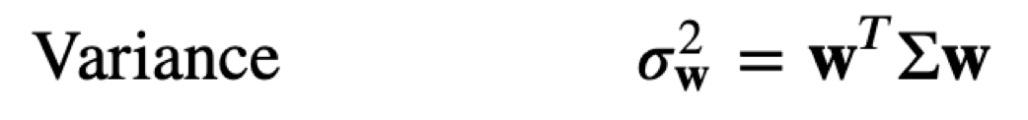

Slide 34
(5,1)

Slide 35
(5,5)
(5,1)

Slide 36
(1,5)
(5,5)
(5,1)

Slide 37
Numpy Array

Slide 38
Numpy Array
Pandas DataFrame

Slide 39
Numpy Array
Pandas DataFrame
Numpy Array

Slide 40
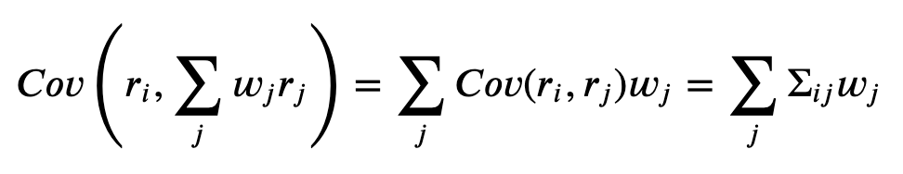

Slide 43
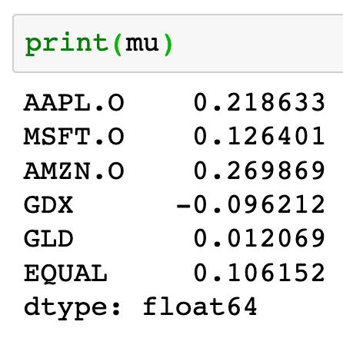

Slide 44
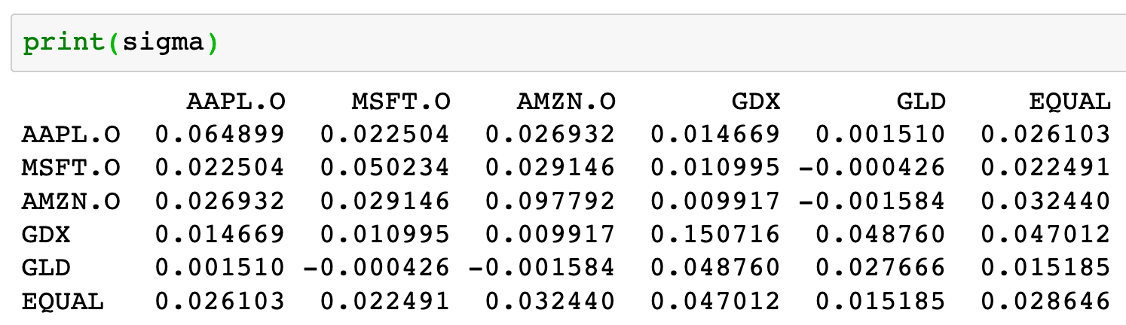

Slide 45
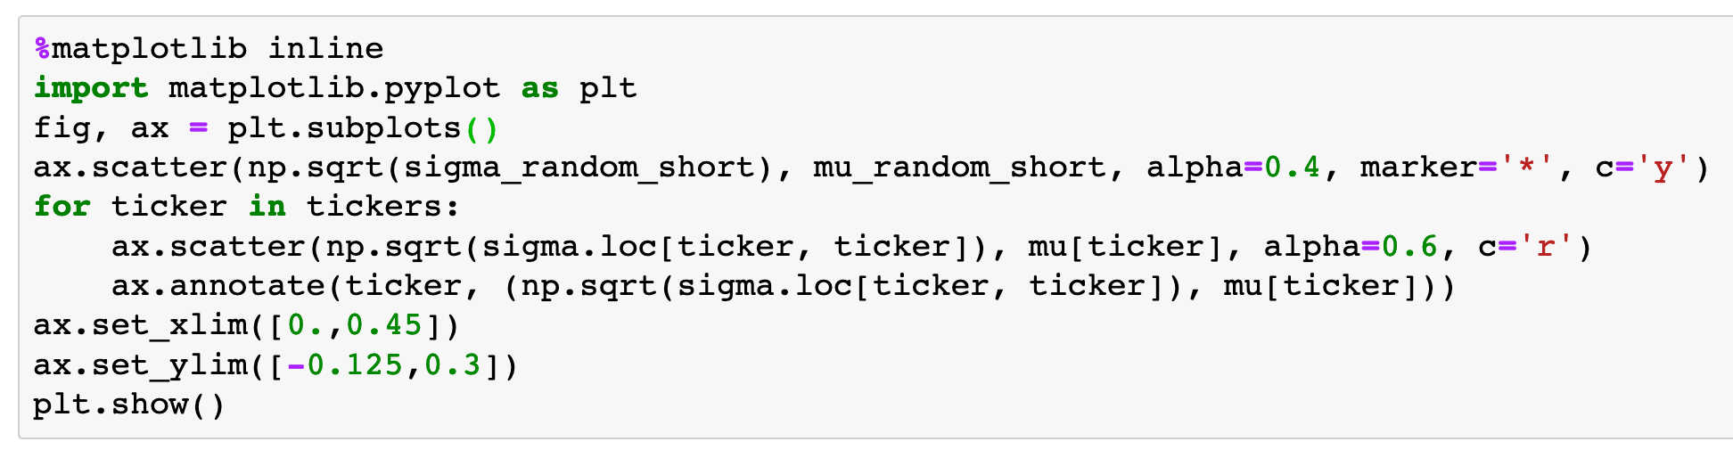

Slide 47
Now
Let’s Play with Code

